Slide 1
Newton Christian School Preschool
Parent Informational Meeting

Slide 2
The Purpose of Preschool:
To foster a love for learning
To prepare for kindergarten
Notes:
NOTE: To change images on this slide, select a picture and delete it. Then click the Insert Picture icon in the placeholder to insert your own image.

Slide 3
OUR MISSION: Nurturing children to discover God and explore learning in a creative environment
Discovering
Exploring
Notes:
NOTE: To change images on this slide, select a picture and delete it. Then click the Insert Picture icon in the placeholder to insert your own image.

Slide 4
This is accomplished through…
Intentional Play: cognitive, linguistic, social, emotional
Exploration: art, music, movement, nature
Spiritual Development: learning right from wrong, relating to God and others
Family Atmosphere

Slide 5
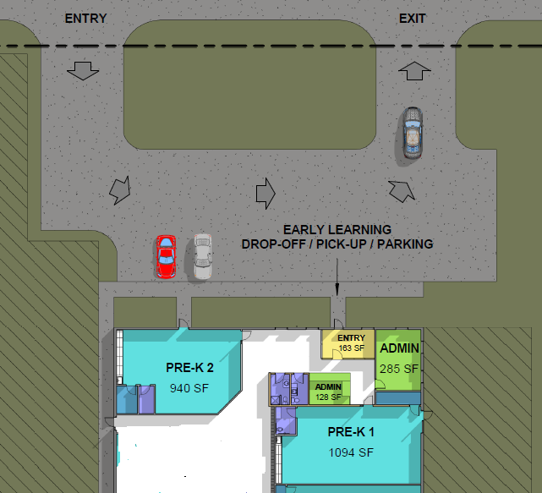
Location: 1711 N 13th Ave E
PLAYGROUND

Slide 6
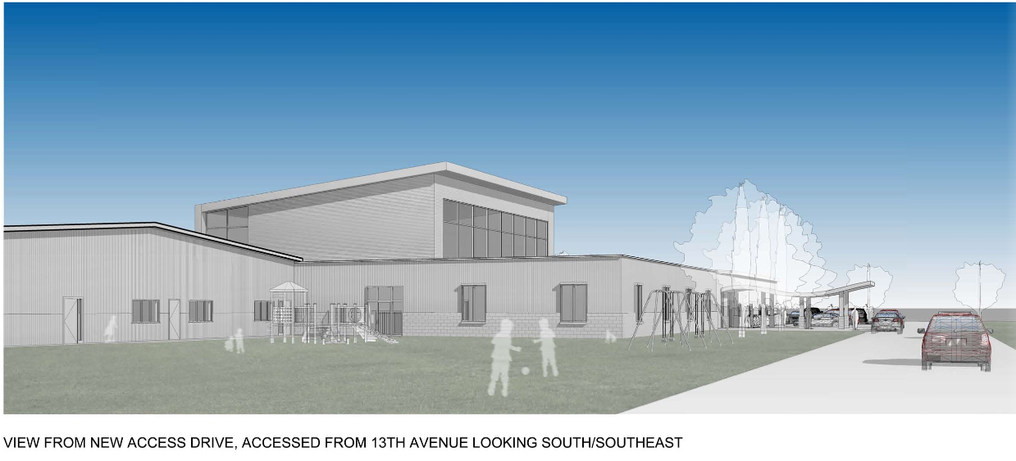
Add a Slide Title - 4

Slide 7
Licensing through Iowa Department of Human Service
Iowa’s Voluntary Quality Rating System for Childcare
Notes:
NOTE: To change images on this slide, select a picture and delete it. Then click the Insert Picture icon in the placeholder to insert your own image.

Slide 8
Staffing:
Preparation
Experience
Adult : Child Ratio
Training

Slide 9
Weekly Schedule 8:05-11:15 a.m. September through May
Discoverers: 3 year olds
Tuesdays & Thursdays
Explorers: 4/5 year olds
Mondays, Wednesdays, Fridays
Notes:
NOTE: To change images on this slide, select a picture and delete it. Then click the Insert Picture icon in the placeholder to insert your own image.

Slide 10
Daily Schedule:
Arrival and table activity Outdoor/Large Motor
Opening Group Small Group
Center Play/ Themed activities Story/Bible Lesson
Music/Movement Dismissal
Snack

Slide 11
Iowa Early Learning Standards
Notes:
NOTE: To change images on this slide, select a picture and delete it. Then click the Insert Picture icon in the placeholder to insert your own image.

Slide 12
Infant through Kindergarten

Slide 13
Curriculum:
Literature rich
Early math concepts
Conversation based
Innovative technology
Professional development
Online resources
Assessments
3-4 year old

Slide 14
Enrollment:
Application
Application Form
Signed Mission/Vision
$35 Non-Refundable Enrollment Fee
Registration
Registration Forms: health, emergency contact, field trip, etc.
First Month Tuition
Sign Up for FACTS

Slide 15
Additional Details:
Tuition/Scholarships
Handbook
Childcare
Activities
K-8 Program

Slide 16
Jesus said, “Let the little children come to me, and do not hinder them, for the kingdom of heaven belongs to such as these.” Matthew 19:14
Notes:
NOTE: To change images on this slide, select a picture and delete it. Then click the Insert Picture icon in the placeholder to insert your own image.

Slide 17
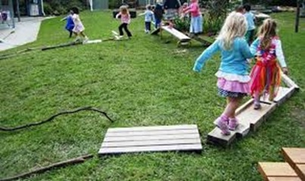
Question and Answer Time

